Slide 1
using bl.ocks.org
and blockbuilder

Slide 2
Ok, what is github.com?
What is gist.github.com?
What is bl.ocks.org?
What is blockbuilder.org?
The same code, viewed three different ways:
https://gist.github.com/almccon/ce995a988bc4f0d7f13cb1236b12a1b9
https://bl.ocks.org/almccon/ce995a988bc4f0d7f13cb1236b12a1b9
https://blockbuilder.org/almccon/ce995a988bc4f0d7f13cb1236b12a1b9

Slide 3
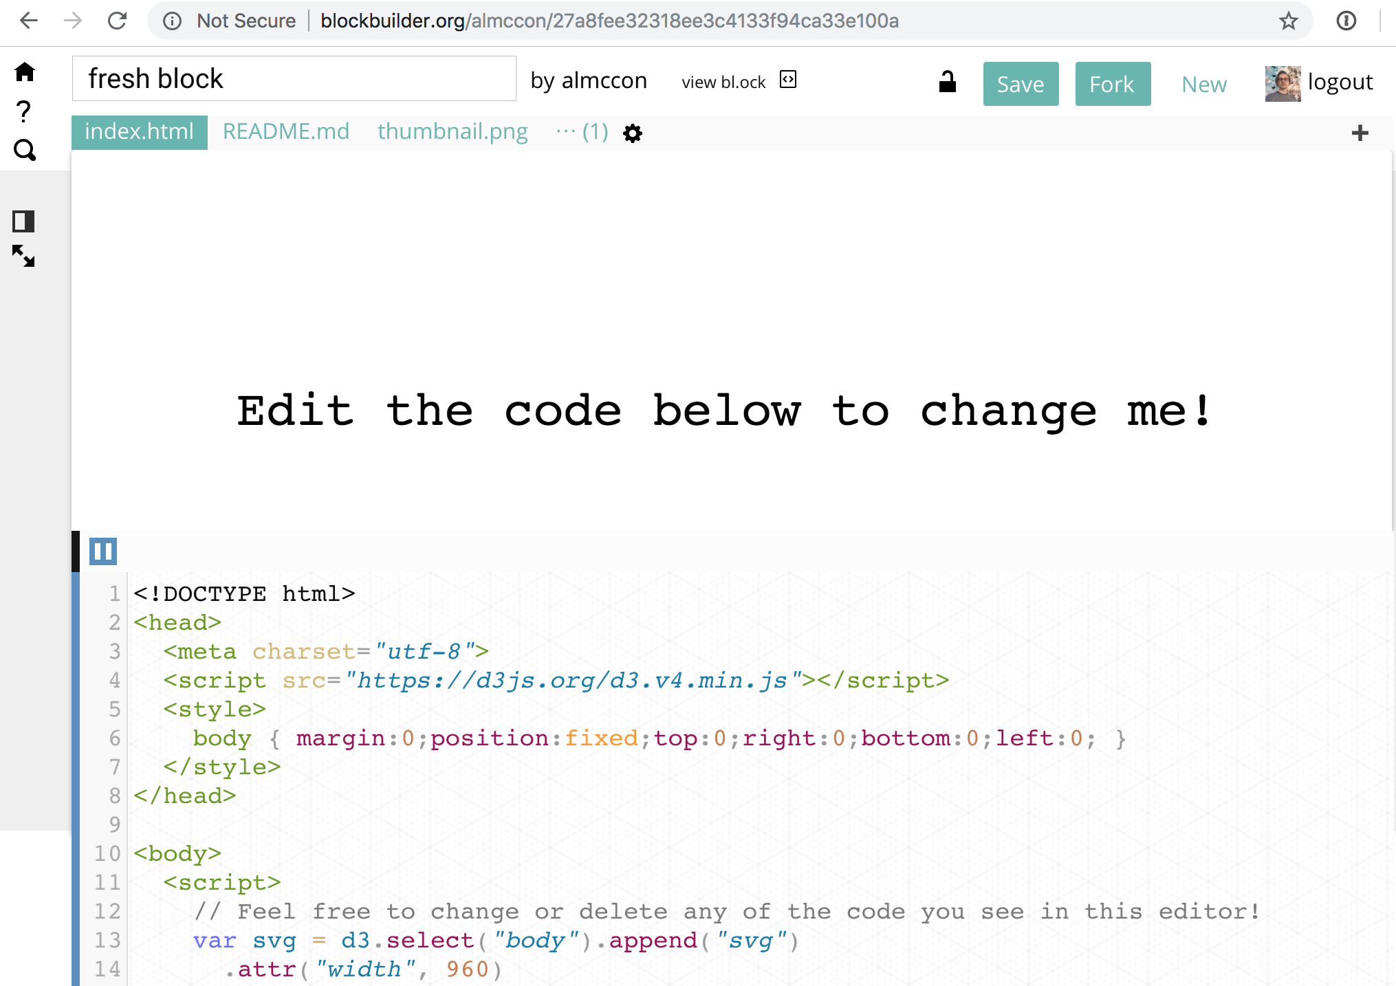

Slide 4
Make your own copy
of someone’s block
(log in with github id first)
Search other
people’s blocks
View the non-editable
version of this block

Slide 5
Especially useful: http://blockbuilder.org/search
A word of warning using examples from bl.ocks.org & blockbuilder.org:
D3 transitioned from version 3 to 4 in 2016, and to version 5 earlier in 2018.
Check which version your examples are using, because some of the function names will be different. The syntax is basically the same.
Look for
<script src=“https://d3js.org/d3.v4.min.js"></script>
or
<script src=“https://d3js.org/d3.v3.min.js"></script>
near the top of the example
Full details: https://github.com/d3/d3/blob/master/CHANGES.md

Slide 6
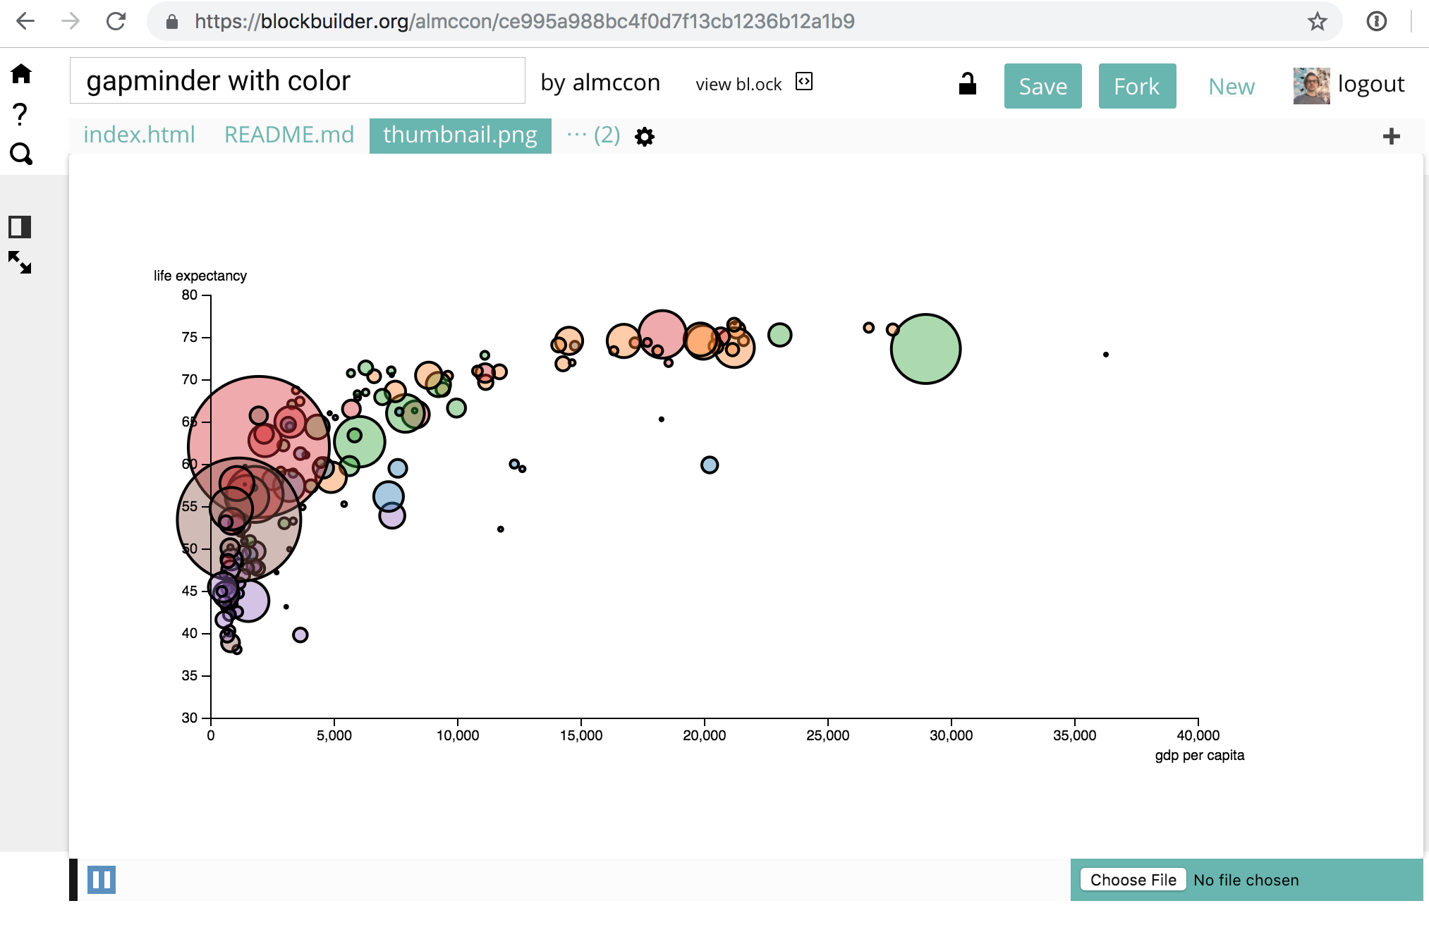
Don’t forget your thumbnail!
Select thumbnail.png
Then upload a screenshot
of your visualization here

